Slide 1
CS 3186
Regular Languages & Regular Grammars
Section 3.1

Slide 2
Regular Expressions

Slide 3
Regular Languages
Regular languages
• are accepted by dfas and nfas
• but dfas and nfas are not concise descriptions
Thus we will examine Regular expressions as a concise representation for regular languages.

Slide 4


Regular Expressions
Regular expressions describe regular languages
Regular expression has a structure or syntax (akin to arithmetic/algebraic expressions)
Regular expression is a string consisting of symbols from the alphabet , parenthesis and operators

Slide 5
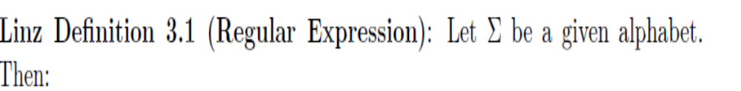
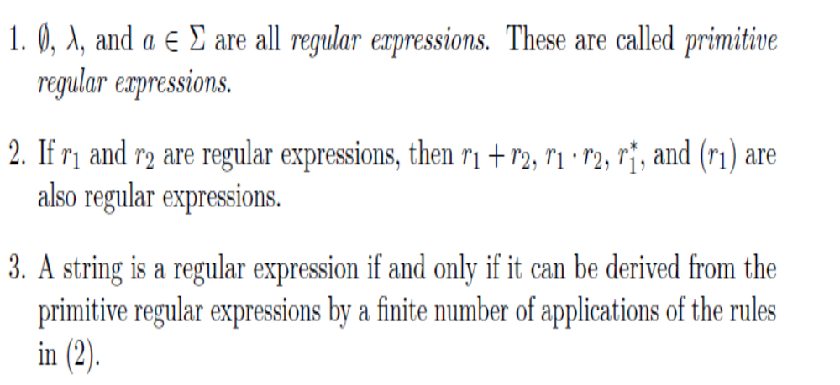
Regular Expressions
Regular expressions describe regular

Slide 6

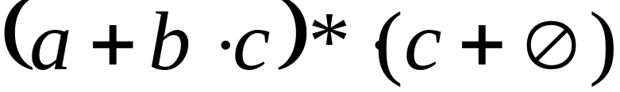
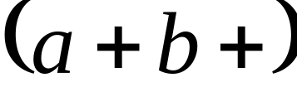
Examples
A regular expression:
Not a regular expression: since it cannot be constructed from primitive regular expressions

Slide 7
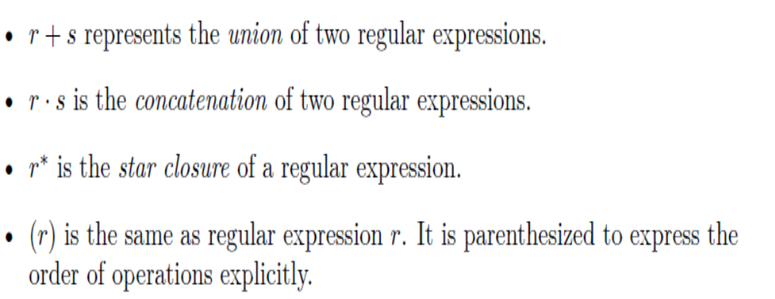
Operators in Regular Expressions

Slide 8

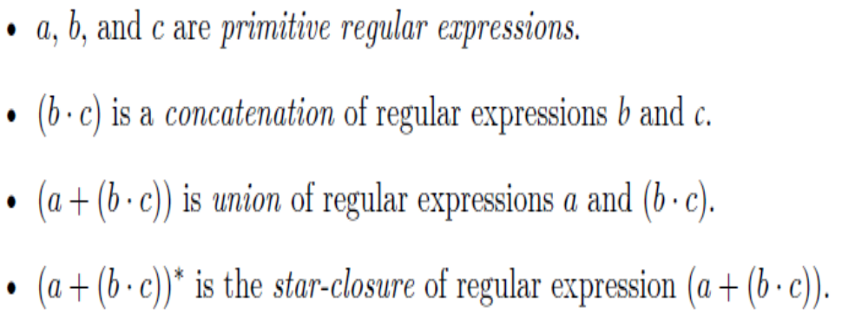
Operators in Regular Expressions
For example, a regular expression

Slide 9
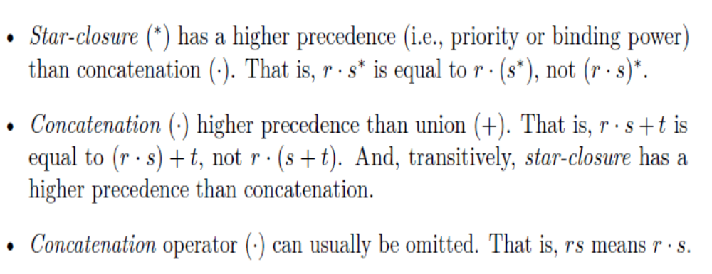
Operators in Regular Expressions
As with arithmetic expressions, precedence rules and conventions can be used to relax the need for parentheses.

Slide 10
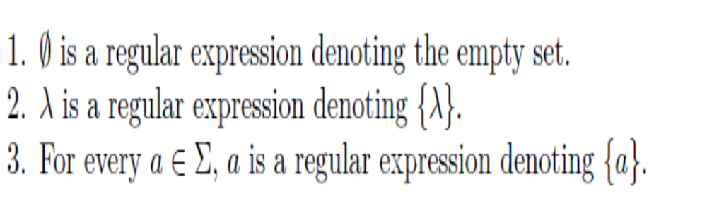



Languages of Regular Expressions
The language L(r) denoted by any regular expression r is defined (inductively) by the following rules.
Base cases:

Slide 11






Definition (continued)
Inductive cases:
If and are regular expressions, then
4.
5.
6.
7.

Slide 12

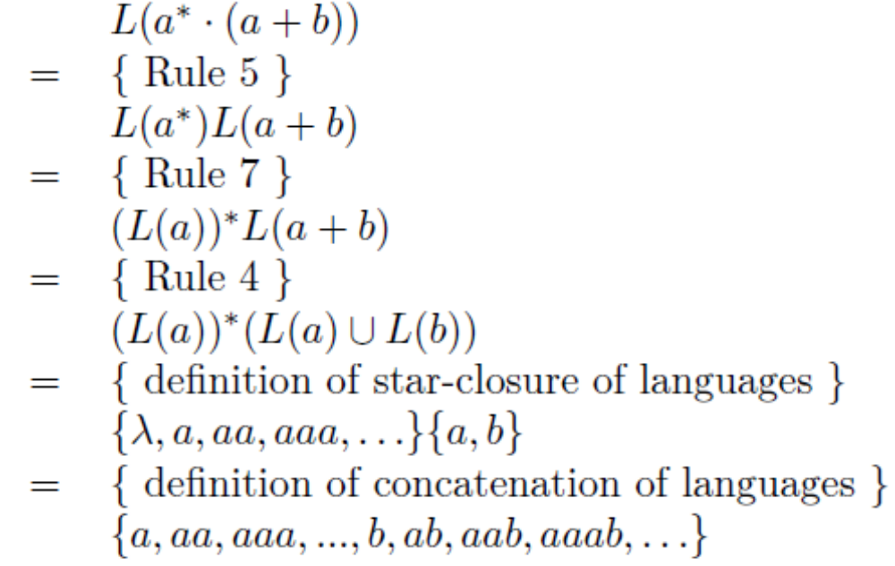
Example
Show the language L(a* · (a + b)) in set notation.

Slide 13



Examples
Regular expression
Regular expression
This expression denotes the set of all strings with an even number of a’s followed by an odd number of b’s.

Slide 14
Regular Expressions
Give regular expressions for the following:
• exactly one “a”
Regular expression: b*ab* (Any number of “b”s before and after “a”)
• at least one “a”
Regular expression: b*a(a + b)* (featuring first a from the left; Any number of b’s before first a and any string after the first a )
Regular expression: (a + b)*a(a + b)* – featuring any “a” in the middle.
Regular expression:(a + b)*ab* – featuring last a
(all three regular expressions above express the same language!)

Slide 15
Regular Expressions
Give regular expressions for the following:
• at most one “a”
Regular expression: b*ab* + b* or b*(a + )b*
• all a’s immediately followed by a b
Regular expression:(b*abb*)* + b*
• at least one pair of consecutive a’s
Regular expression: (a + b)*aa(a + b)* [Before and after “aa”, there is any arbitrary string]

Slide 16

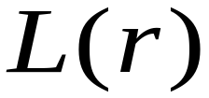

More Regular Expressions
= {all strings without two consecutive 0 }
Any arbitrary string before and after 00
Regular expression: r = (0 + 1)*00(0 + 1)*
= {all strings without two consecutive 0 }
Any repetitions of 1 and 01
Avoids two consecutive 0s
Regular expression :

Slide 17
Regular Expressions
Give regular expressions for the following:
L = {a^{n}b^{m} | n > 4, m <3}
Account for all possibilities (minimum of 4 a’s followed by 0 or 1 or 2 b’s
L = aaaaa*( +b+bb)
Give the regular expression for the complement of L
Account for all possibilities; split into several cases.
n<4 (when b’s follow a’s) or m>3 (when b’s follow a’s) or any possible occurrences of a following b.
L =( +a+aa+aaa)b* + a*bbbb* + (a+b)*ba(a+b)*

Slide 18

Equivalent Regular Expressions
Definition:
Regular expressions and
are equivalent if

Slide 19
I) Do Exercises: #1, #2, #7, #8, #9, #10, #13, #14, #20(a)
II) Given input alphabet Σ = {0.1). Give regular expressions for the following: a. {w| w begins with a 1 and ends with a 0} b. {w| w contains at least three 1s} c. {w| w contains the substring 0101} d. {w| w has length at least 3 and its third symbol is a 0} e. {w| w starts with 0 and has odd length, or starts with 1 and has even length} f. {w| the length of w is at most 5}
Homework 3.1

Slide 20
CS 3186
Regular Expressions and Regular Languages
Section 3.2

Slide 21
NFAs revisited
NFA’s can typically be defined with many final states.
Any NFA can be converted to an equivalent NFA with a single final state as an easy step.
NFA with a single final state becomes easy to describe properties of regular expressions and regular languages.

Slide 22



Example
NFA with two final states
Equivalent NFA (create a new final state and add transitions from the prior final states to the new final state. The previous final states become non-final states.

Slide 23
NFA with one final state
NFA with more than one final state
General rule to convert to an equivalent NFA with one final state
Single
final state

Slide 24
NFA with one final state
Extreme case: NFA without final state
Add a final state
Without transitions

Slide 25
Regular Expressions and Regular Languages

Slide 26

Theorem
Languages
Generated by
Regular Expressions
Regular
Languages
Regular expressions denote Regular languages.
Regular languages are represented by a regular expressions.
Both (1) and (2) are proven by construction

Slide 27

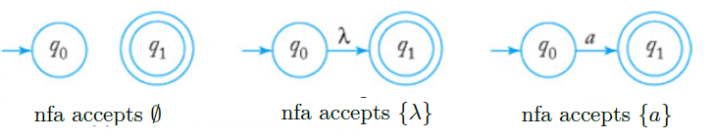
Regular Expressions denote Regular Languages
Theorem 1 (NFAs for Regular expressions): Let r be a regular expression. Then there exists some nondeterministic finite accepter (nfa) that accepts L(r). Consequently, L(r) is a regular language.
Proof: By construction.
There are nfas that correspond to the primitive regular expressions

Slide 28
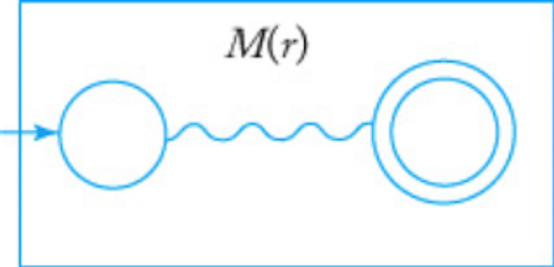
Theorem 1 (proof continued)
NFA can be represented schematically as M(r) that accepts the regular language L(r) denoted by regular expression r. Note the NFA is represented with an initial state and one final state.
Schematic representation of an nfa accepting L(r)
Assume that we have automata M(r₁) and M(r₂) that accepts languages denoted by regular expressions r₁ and r₂.

Slide 29
Theorem 1 (proof continued)
Construct a new nfa as follows.
Create a new initial and a new final state.
Use -transitions to create a new composite nfa by connecting the two nfa’s to the new initial and final states. (remove designations of initial and final states from the two machines)
Construct nfa for L(r₁+r₂), L(r₁ r₂), L(r₁*).
By stringing together several such steps, this process illustrates composing nfas for any regular expression from the nfas for its subexpressions.

Slide 30
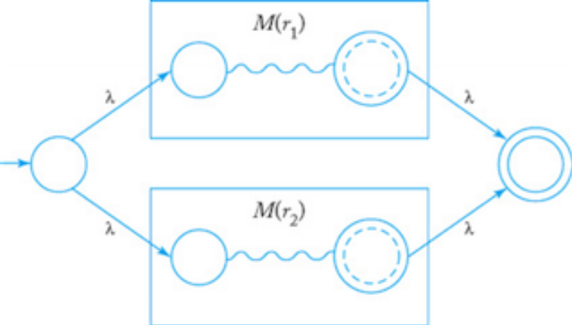
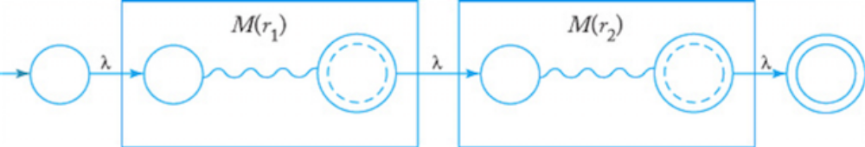
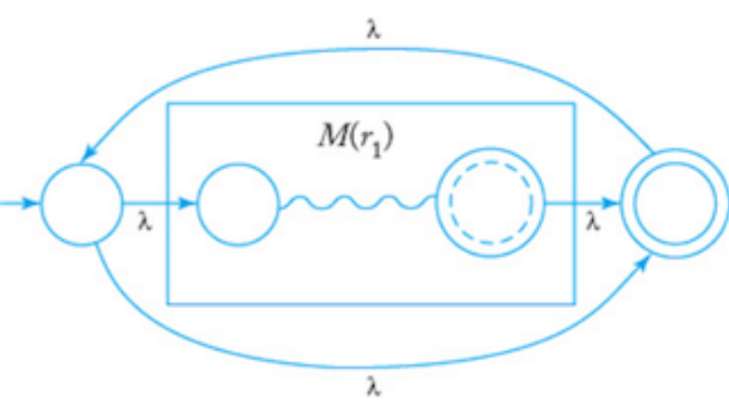
Proof (continued)
nfa for L(r₁+r₂)
nfa for L(r₁r₂)
nfa for L(r₁*)
(Note the use of transitions to construct the new nfa).

Slide 31
Example
Show an nfa that accepts r = (a + bb)*(ba* + ).
nfa accepts L(a)
nfa accepts L(b)
nfa accepts L(bb)
nfa, M₁ accepts L(a+bb)*
nfa accepts L(b)
nfa accepts L(ba*)
nfa accepts L(ba*)
nfa, M₂ accepts L(ba*+ )

Slide 32
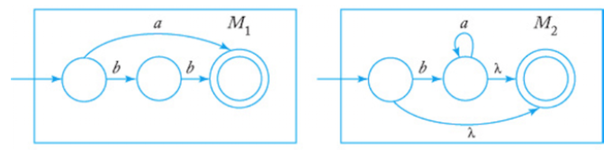
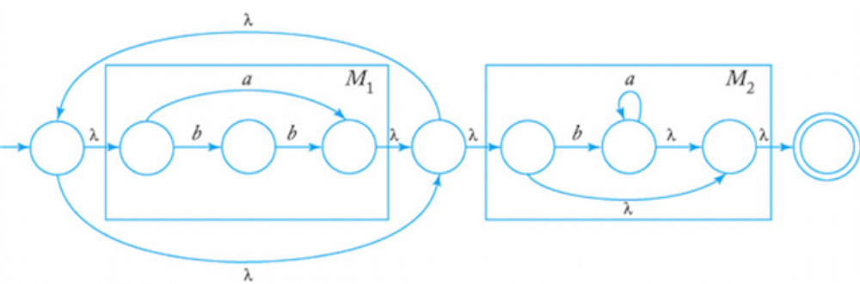
Example
Show an nfa that accepts r = (a + bb)*(ba* + ).
M₁ accepts L(a+bb)
M₂ accepts L(ba*+ )
nfa accepts r = (a + bb)*(ba* + ).

Slide 33
Regular Languages represented by Regular Expressions
Theorem 2 (Regular Expression for nfa): A regular language can be expressed by a regular expression r.
Proof: By construction.
For the given a regular language, there exists an nfa
Algorithm:
Create a new start state s, and connect this to the original start state with an edge labeled .
Create a new final state f, and connect the original final states to this state by edges labeled .

Slide 34
Theorem 2 (proof continued)
For each pair of states i and j that has more than one edge connecting them, replace all the edges with the regular expression formed using union (+) to combine the labels on the previous edges.
Construct a sequence of new machines by eliminating one state at a time until the only states remaining are s and f. To eliminate some state k, construct a new machine as follows:

Slide 35
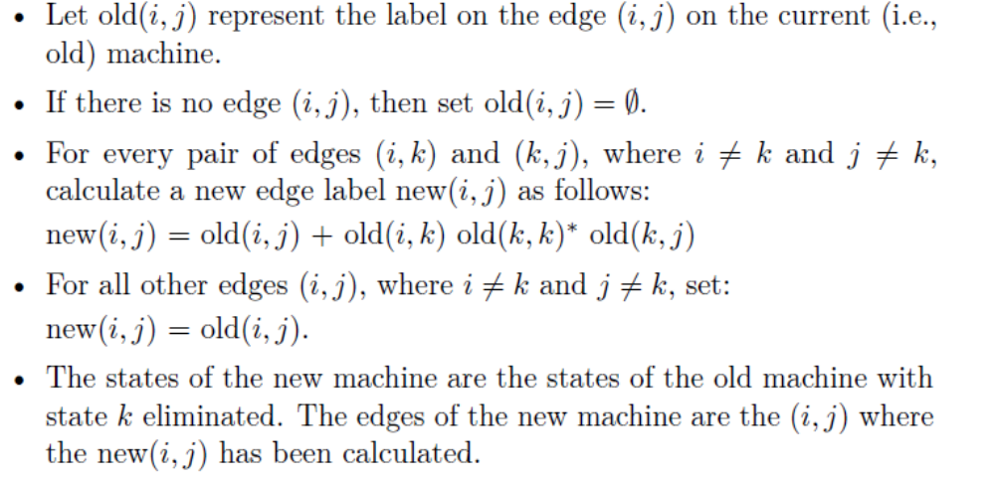
Theorem 2 (proof continued)
After eliminating all states except s and f, the regular expression is the label on the one edge remaining.

Slide 36
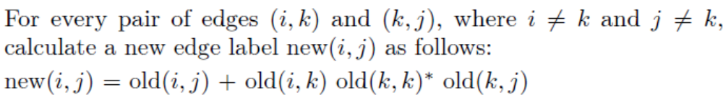
Why?
Explanation

Slide 37
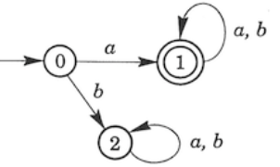
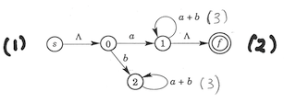
Example
Describe a regular expression for the nfa; Q=(0,1,2)
After applying Rule 1 (new start state), Rule 2 (new final state), and Rule 3 (create union), we get the following nfa.

Slide 38
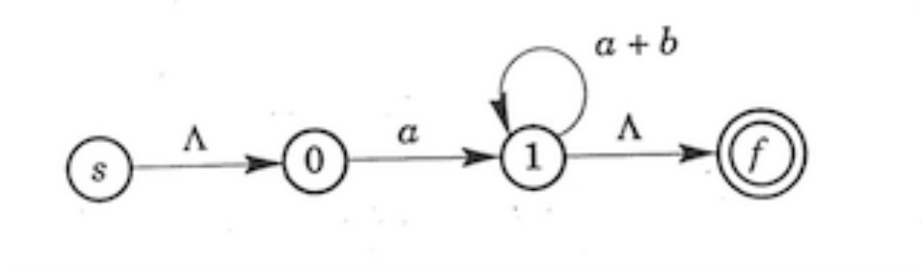
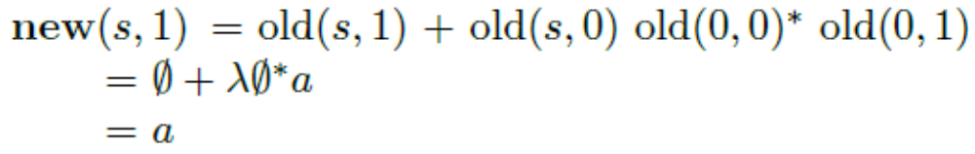
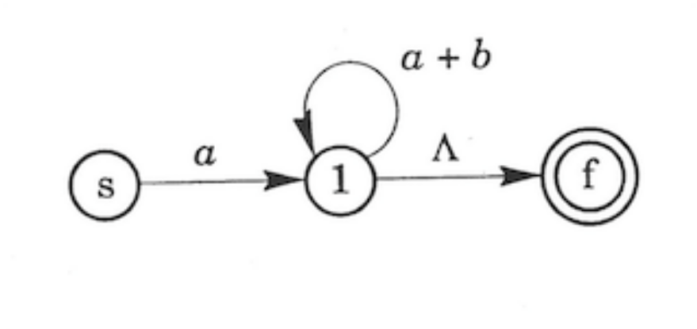
Example (continued)
Eliminate state 2 as it is a trap state. i.e., there is no path through 2 to the final state.
Eliminate state 0 by adding an edge (s,1) using rule 4

Slide 39
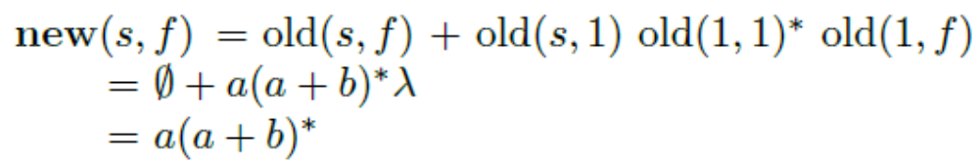
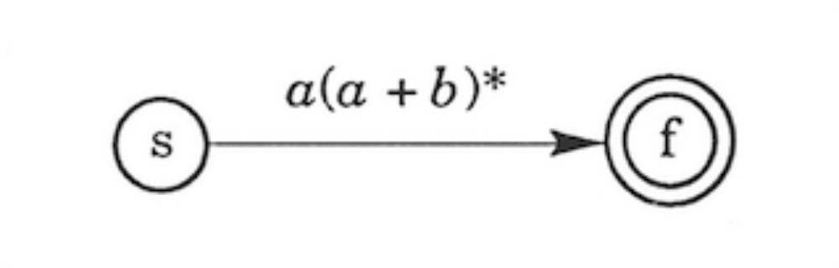
Example (continued)
Eliminate state 1 by adding an edge (s,f) using rule 4
Thus the regular expression is a(a + b)*

Slide 40
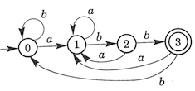
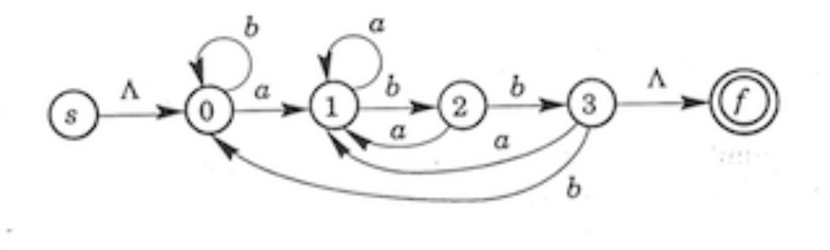
Another Example
A regular expression for the nfa Q=(0,1,2.3)
After applying Rule 1 (new start state), Rule 2 (new final state), we get the following nfa.

Slide 41
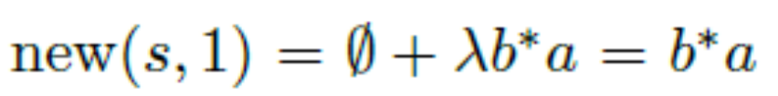
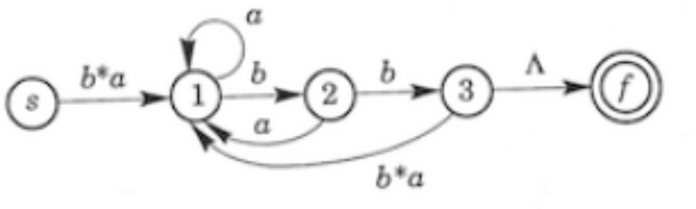
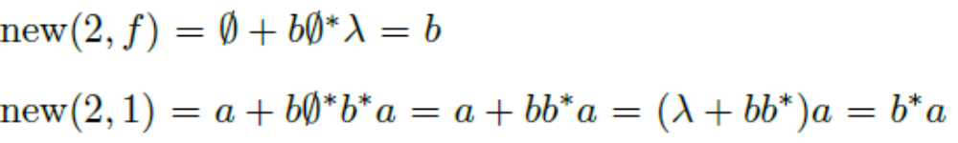
Another Example (continued)
Eliminate state 0 by adding new edges (s,1) and (3,1)
Eliminate state 2 or state 3. Let us choose state 3

Slide 42
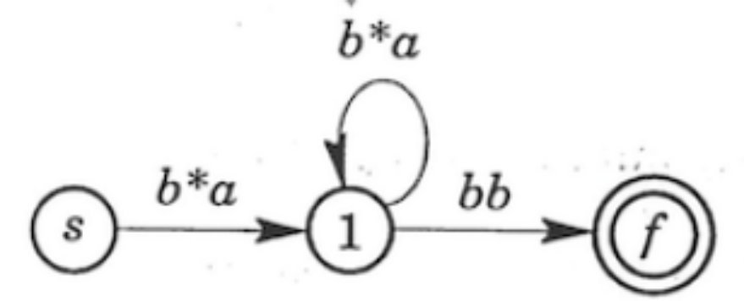
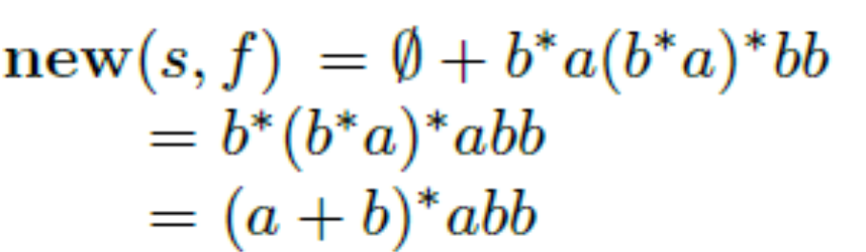
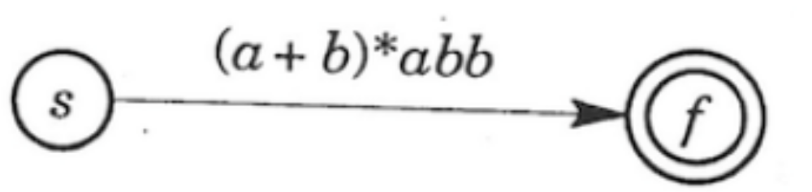
Another Example (continued)
Next eliminate state 1

Slide 43
(I) Do Exercises: # 1.
(II) Convert the above into an equivalent DFA
(III) From above, give a DFA that accepts the complement of the language
(IV) From above, express the complement of the language as a regular expression.
(V) Do Exercises: #6, #7(a)
(VI) Do Exercises: 8, 9 (write an nfa and then convert to DFA
(VII) Do Exercise: #11, #12
Homework 3.2

Slide 44
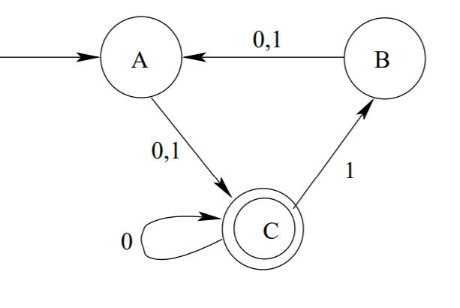
(VIII) Find the Regular Expression for the following:
(IX) From the NFAs constructed in problem in Exercise #6, construct the regular expression back step by step.
Homework 3.2

